Slide 1
Data Flow Diagram
Examples

Slide 2
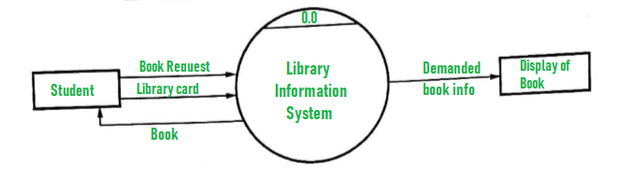
Library Information System (DFD Level 0)

Slide 3
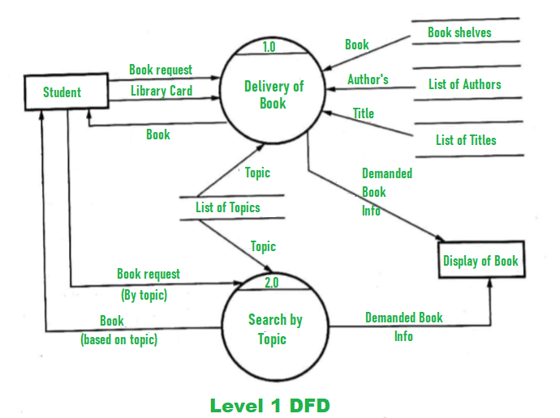
DFD Level 1

Slide 4
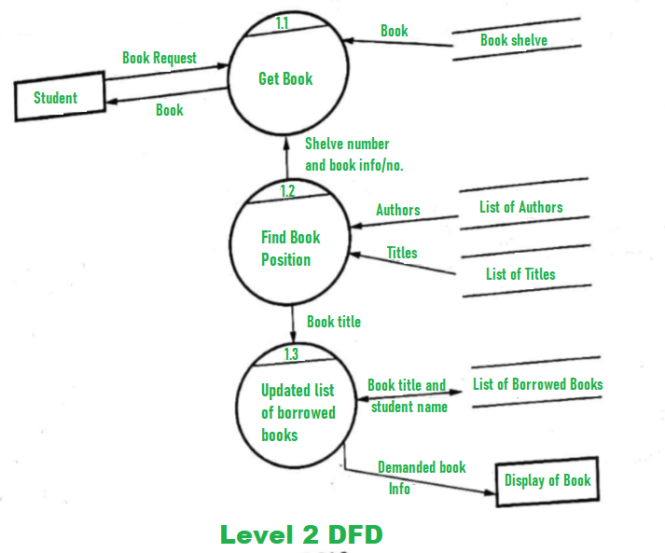
DFD Level 2

Slide 5
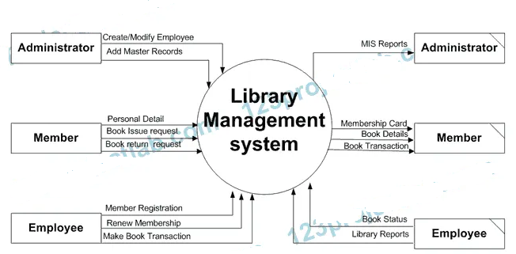
Library Management System DFD Level 0

